Slide 1
“Turtleback Tombs” (1966) Ôshiro Tatsuhiro (1925-2000)
亀の甲墓
大城立裕

Slide 2
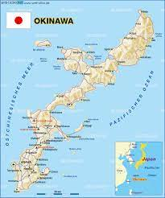
Map of Okinawa

Slide 3
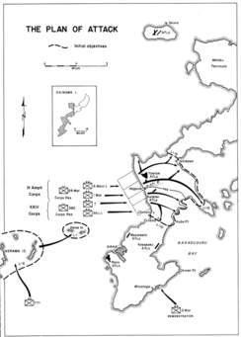
Battle of Okinawa, April 1-June 23 1945

Slide 4
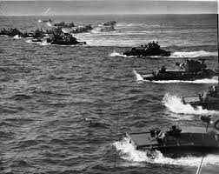
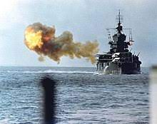
April 1, 1945 attack

Slide 5
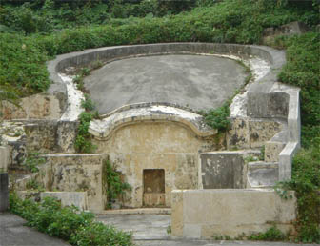
Turtleback Tomb

Slide 6
Keywords
Turtleback tombs
Experimental language
Ancestor worship, O-bon
Filial piety
Spirit (mabui)
Personification
Ôshiro’s political stance: ika/dôka (difference, assimilation)
Pedagogue: tomb (123); spirit stuffing (138)
Names: Ushi, Take, Tami-ko
Notes:
http://www.asahi-net.or.jp/~qk3m-knk/oki-pho-haka.htm

Slide 7
Discussion Questions
Compare and contrast “Cocktail Party” and “Turtleback Tombs.” Why would Ôshiro prefer the latter received more recognition than the former?
What is the central theme of “Turtleback Tombs”?
What is Ushi’s role in the family? What is Eitarô’s role?
4. In what way are the educated characters (councilman, principal) similar to other such characters we’ve read?

